Slide 1
Introducing the Grid Project Impacts Quantification Web Calculator
28 August 2018
Updated: October 22, 2024
Presented by:
Pacific Northwest National Laboratory
gridpiq.pnnl.gov
PNNL-SA-137754

Slide 2
“If Only I Could Quickly and Easily…”
Ask many “what if?” questions about my system
Screen grid projects
Visualize grid time series
Compare assumptions
Sanity check results
Check for knock-on benefits or unintended consequences
Document benefits of my project or product
Leverage many data sources in one place

Slide 3
Introducing the Grid Project Impact Quantification Tool (GridPIQ)
Screening tool for grid projects – various technologies (e.g. energy storage, PV) and impacts (e.g. inter-hour ramping, emissions, peak power)
Publically available right now – gridpiq.pnnl.gov
Transparent methodologies and data sources
Built in online instructions and explanation of methodology
Intuitive user interface
Notes:
Now you can. Eric Lightner was motivated to ask just these kinds of what if questions, and it resulted in the development of this tool.
The focus is to bring together publicly available data to make it easy for anyone – big utilities, small utilities, product vendors, policy makers, regulators, citizens – to quickly understand what smart grid technology can do.
It’s a scratch pad,
A chance to compare assumptions
A way to visualize the way your system changes over time.
The focus is on transparency: No secret sauce. We’re using methodology vetted in the literature, or as simple as possible and well documented.
We see it used most commonly to determine where more detailed analysis (power flow) might be required, to sanity check results you’ve been handed.
You don’t have to to be a researcher to use this simple tool

Slide 4
How does it work?
User inputs a few simple things to see results in seconds
For example: Technology type, efficiency, size, location
Completely customizable
Change parameters to
explore assumptions,
compare scenarios, or
tune the results to your specific location for maximum applicability
User cautioned when boundaries of the GridPIQ model are pushed

Slide 5
Use Case and Demo: Amplify your own analysis
You have deployed a project on a distribution feeder and measured hourly power time series (MW)
You’ve already got a scenario and would like to do quick screening or sanity check of results
Report additional insight
Changes fuel costs
Changes ramp rates
Changes emissions
Changes energy usage… etc
Your Analysis
Before + after
Hourly .csv
Power
GridPIQ
Upload data, define context
Results
Notes:
Example shown:
Simulation of a single 12.47 kV feeder
Climate region 4 is the non-coastal South East and central areas of the United States and is characterized by a hot and cold climate.
This feeder is a representation of a heavily populated urban area with the primary feeder extending into a lightly populated rural area. In the urban areas the load is composed on moderate commercial loads with single and multi-family residences. On the rural spur the load is primarily single family residences. Approximately 92% of the circuit-feet are overhead and 8% underground. This feeder has connections to adjacent feeders in the urban area, but limited connections in the rural areas. For this reason it would be common to limit the feeder loading to 50% to ensure the ability to transfer most of the loads from other feeders, and vice versa. Most of the urban load is located near the substation while the rural load is located at a substantial distance.
Nodes 571 Voltage (kV) 13.8 Load (kW) 5,550 Voltage Regulators 0 Reclosers 1 Residential Transformers 333 Commercial Transformers 41 Industrial Transformers 0 Agricultural Transformers 0
Before and after VVO implementation for year round energy savings
Quickstart
Say you don’t need all the bells and whistles – you have your own data about before and after your technology’s in the system.
For example, here’s a problem Brandon recently came across on another project…

Slide 6
Use Case and Demo: Energy Storage
Characteristics you input:
Battery size,
location characteristics,
dispatch objective
Expect Insight about how the battery changes the system’s:
Net Load Profile (MW)
Energy consumption
Peak Power
Ramping requirement from other generators
Carbon footprint
Etc.
Now let me step you through…

Slide 7
Overview of Available Technologies

Slide 8
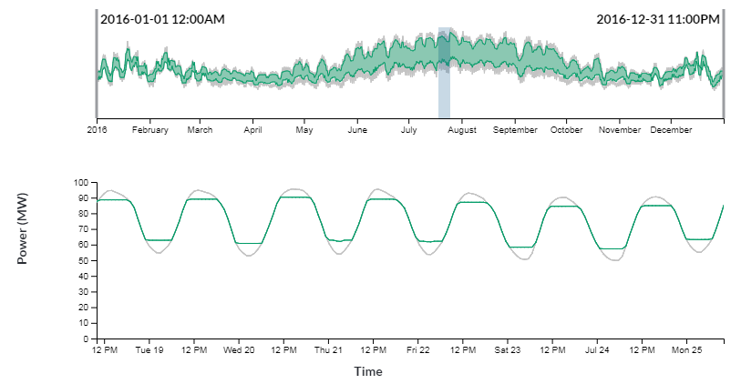
Energy Storage
Market Participation
Operate storage to maximize profit
Input prices
Discover operating profile and consequences
Based on PNNL work: D Wu, C Jin, P Balducci, M Kintner-Meyer
Daily Peak Shaving
Operate storage to “peak shave and valley fill”
Quadratic program developed by Emily Barrett

Slide 9
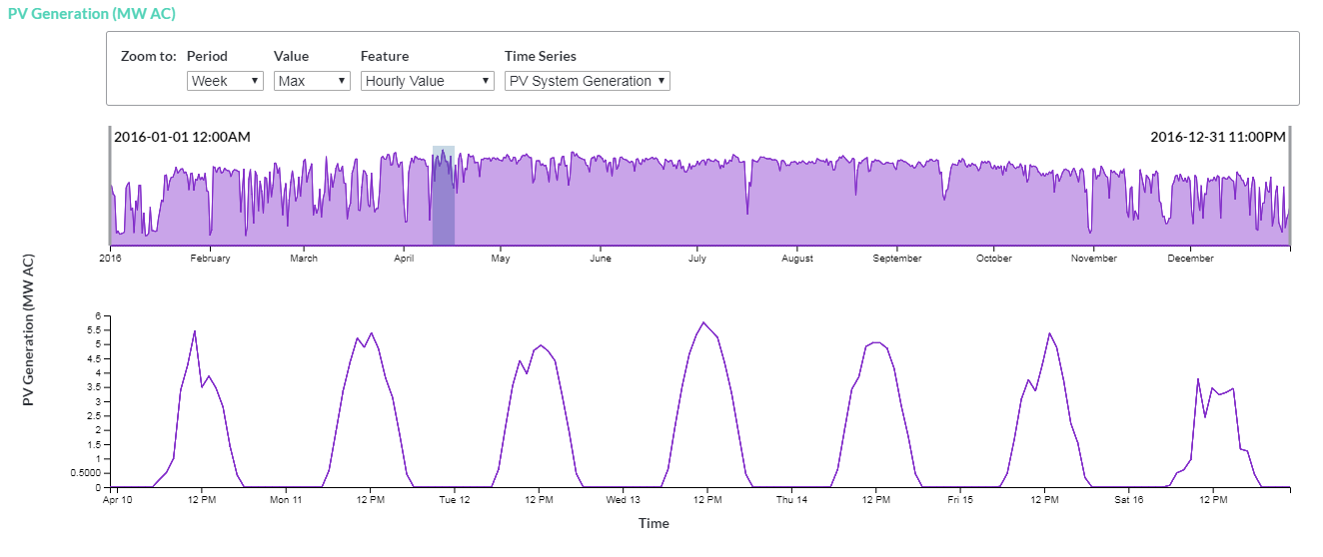
Photovoltaics
Upload PV generation profile, or model PV output
Modeling directly uses NREL’s PV Watts, part of the System Advisor Model

Slide 10
Electric Vehicle Coordinated Charging
Use typical charging behavior to compare with coordinated charging
Charging data from Idaho National Laboratory’s EV Project

Slide 11
What’s Next?

Slide 12
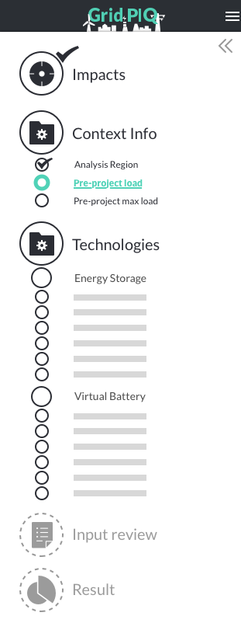
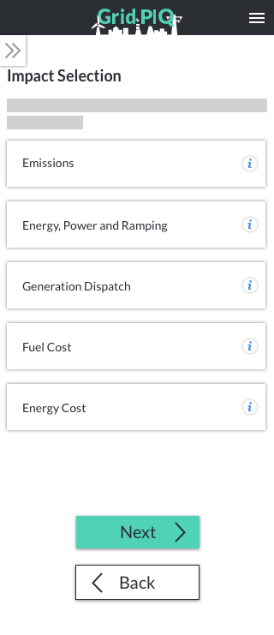
GridPIQ 2.0
Enable different tech combos
Choice of results
Improved mobile design
Quicker/improved Performance
More options for customizing scenarios

Slide 13
Get involved!
Use the calculator: GridPIQ.pnnl.gov
Partner for analysis
Incorporate your methodology or tool with GridPIQ
News about this and other Advanced Grid Research on SmartGrid.gov
gridpiq@pnnl.gov
Notes:
Our executive steering committee, composed of utilities, regulators, vendors, federal agencies, and trusted consultants, will meet again this fall. If you would like to join us, please email or call to find out more details.
Use the calculator – put it through its paces
If you have data, let’s validate the tool’s results or publish an analysis paper together
Again, this calculator is modular and transparent.
Thank you for your interest today – GridPIQ is a living, breathing, developing project and if you find it valuable, I hope you’ll consider getting involved with us on the steering committee, as a partner, or just by giving us your comments.

